Slide 1

Saving Sylvester
A Java-based Adventure

Slide 2
The Story
In a book written by P.F. Tollers, the main character, known as Prince Sylvester, dies at the end of the story
A mysterious woman appears to you with a portal that can transport you into the story so you can change the ending and save Sylvester.

Slide 3
The Characters
P.F. Tollers – the author of the story
Player – you
Prince Sylvester – the protagonist of the story and who must be saved
Candice – the mysterious woman who gives you the portal

Slide 4
Environments and levels
Your room (1 area)
The Lab (1 Area)
The garden (9 areas)
The dungeon (10 areas)
The palace (9 areas)
The tower (1 area)

Slide 5
Game Format and Game Play
The game is all text-based
You can grab items and make your way through the story with text commands
Throughout the game, you have to solve riddles to continue and find keys to unlock various doors
There is one boss, the Knight, who can be defeated by picking up a bow and arrow in the dungeon, he gives you the key to the final room when you defeat him

Slide 6
Game Requirements
The game is java-based and can run on all operating systems
The game must be played with a keyboard and mouse
Speakers are recommended to hear the game’s music

Slide 7
TimeLine
Decided to make a text based game and came up with the story and characters.
Decided to use libGDX but abandoned to only java.
Made the GUI with Images and got movement and inventory to work.
Added music and items
Made the rooms and areas
Wrote the rooms and bug fixing.

Slide 8
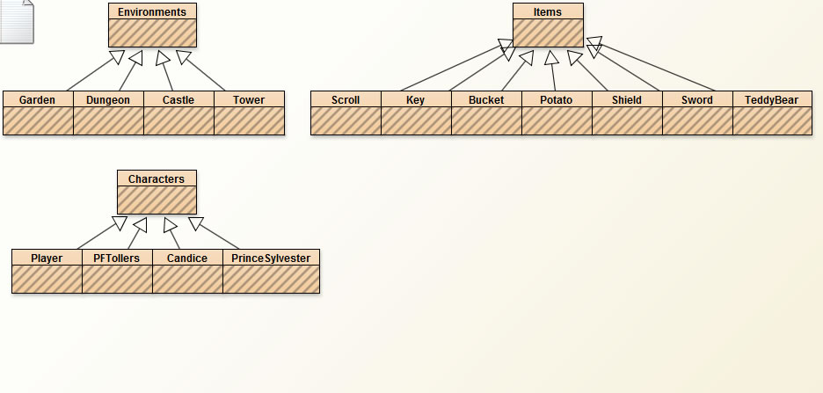
Class Diagram of the Game

Slide 9
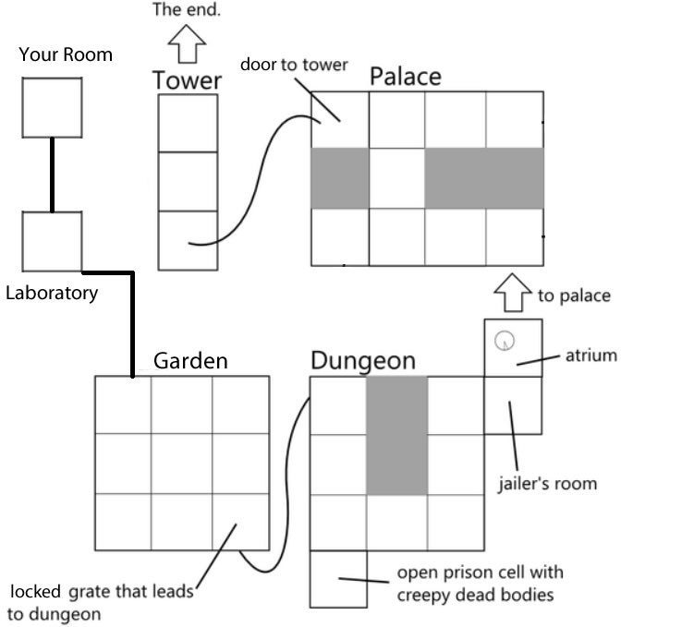
Game Map

Slide 10
Things we changed before the final game
We started off using lib gdx and went to Java
Removed a lot of characters
Instead of riddles for every room, we decided to make only one at the end
Decided that instead of making each room a class, make them in an array list

Slide 11
Things we learned
Lib GDX is awful for text based games
Don’t bite off more then you can chew
Git Hub doesn’t “git” you anything except errors
Making text based games is more complex then we thought

Slide 12
Credits: Story: Jack Mertens Jordan Kifer Coding: Zachary Conrad Jack Mertens Nathan Petterway Jordan Kifer Music: Brett Gardner Pictures: Cody Templet Jack Mertens Debugging/testing: Cody Templet Zachary Conrad Presentation: Cody Templet Nathan Petterway

